Slide 1
FIRST Robotics Competition
By Matthew Stringer

Slide 2
What is FIRST
FIRST is a nonprofit organization that works to inspire students to pursue STEM
FIRST stands for “For Inspiration and Recognition of Science and Technology”

Slide 3
FIRST Programs
FIRST Lego League Jr
Introduces young children to science and coding concepts through hands-on, playful building challenges.
Grades K-4
FIRST Lego League (FLL)
Students program autonomous robots and design an innovative solution related to the annual theme.
Grades 4-8
FIRST Tech Challenge (FTC)
Teams design, build, and program robots, develop strategy, and engage in thrilling, head-to-head competition.
Grades 7-12
FIRST Robotics Competition (FRC)
Teams compete with 125-pound robots, combining the excitement of sport with the rigors of science and technology
Grades 9-12

Slide 4
FIRST Robotics Competition (FRC)
Students build 125-pound robots in a 6 week period
The robot must follow strict rules from a 150 page manual
Teams of high school students are challenged to build industrial-size robots to play a difficult field game in alliance with other teams

Slide 5
Students get to
Develop design, project management, programming, teamwork, strategic thinking, and Coopertition skills
Work alongside professional engineers
Build and compete with a robot of their own design
Learn and use sophisticated hardware and software
Access exclusive scholarships from hundreds of colleges/universities

Slide 6
Impact
75% of FIRST Alumni are in a STEM Field as a student or professional
2x as likely to show gains in their interest of STEM
87% of participants plan to take a more challenging Math or Science Course
FIRST Alumni are 2.6x more likely to enroll in an engineering course their freshman year

Slide 7
Build Season
Starts in early January
6 weeks to design, build, and program your robot

Slide 8
Kennedy Robotics (3250) Robot 2018

Slide 9
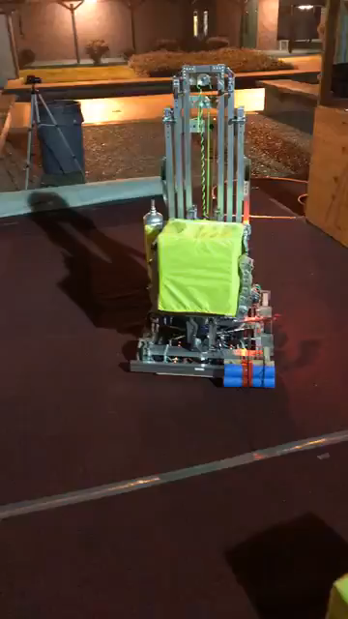
Running the 2018 robot for the first time

Slide 10
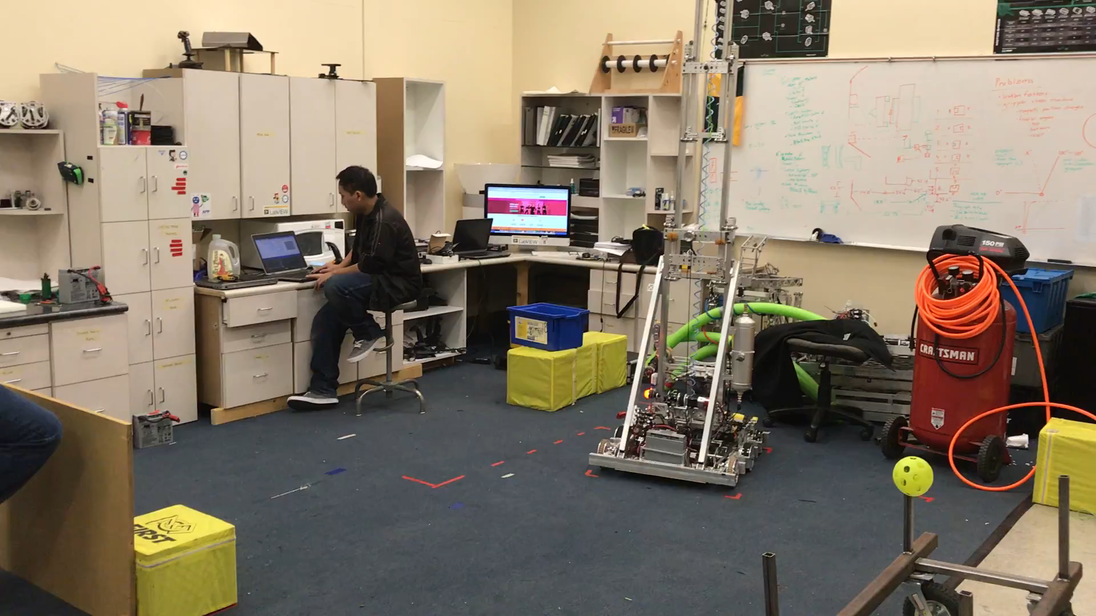
Testing Autonomous code

Slide 11
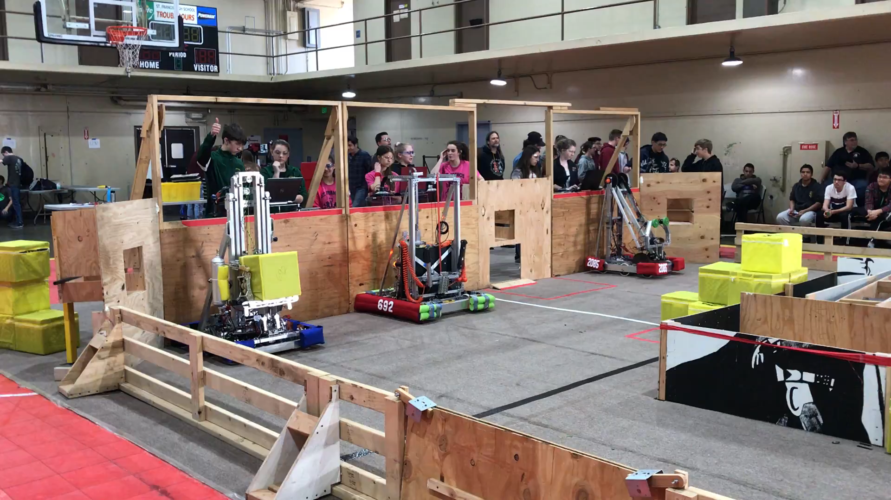
Running Autonomous Code on Practice day

Slide 12
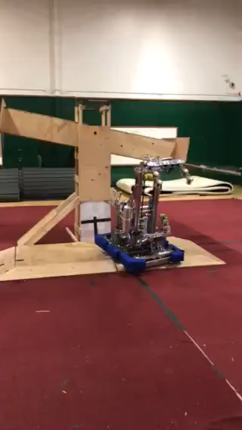
2018 Climb Testing

Slide 13
Playing at Sacramento

